Slide 1
Hello There
A Certain Scientific Regex

Slide 2
Chall Text (Not Actual Font Size)
One of the strings

Slide 3
Chall Text: Junk Generator
Website: http://www.unit-conversion.info/texttools/random-string-generator/
Allowed chars: abcdefghijklmnopqrstuvwxyzABCDEFGHIJKLMNOPQRSTUVWXYZ0123456789~`!@#$%^&*()-=_+[]{}\|;':",./<>?012345678901234567890123456789
Numbers are repeated to get more digits
Strings: 1
Length: 50 000

Slide 4
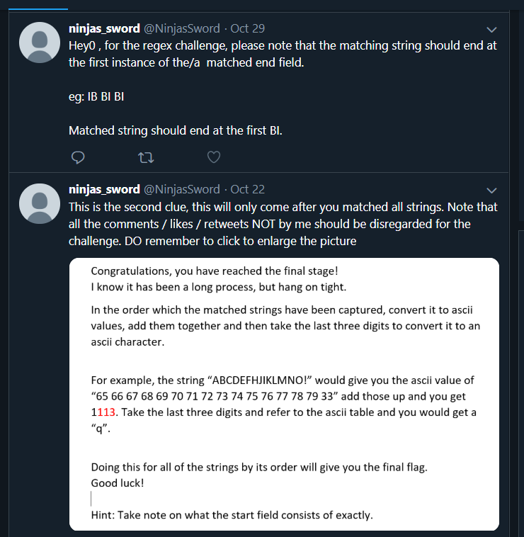
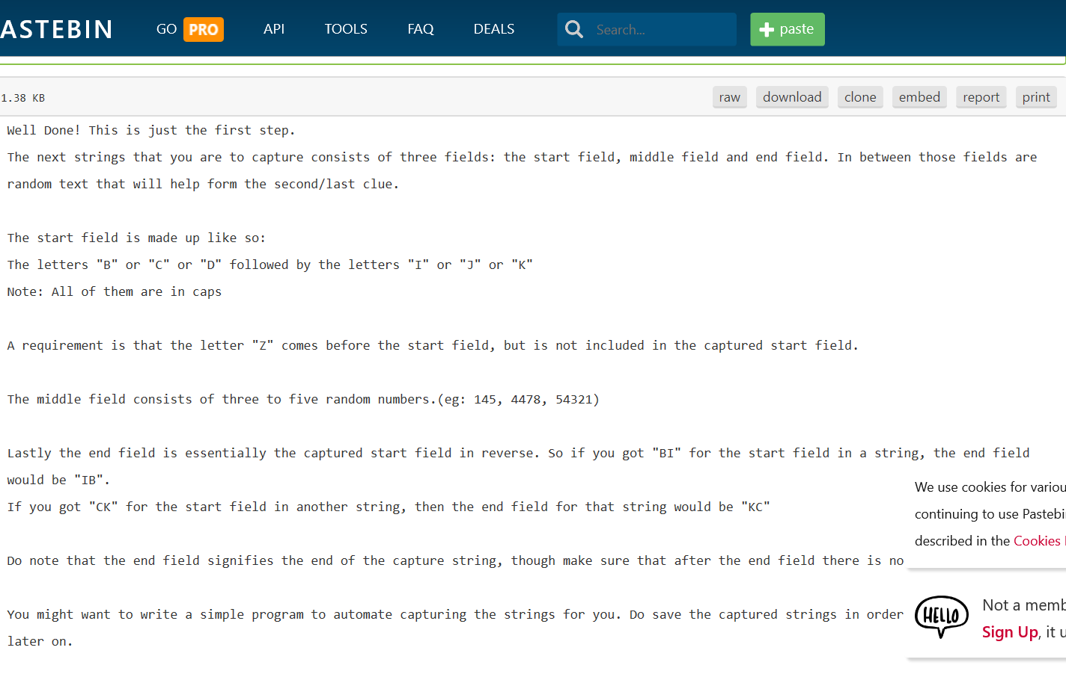
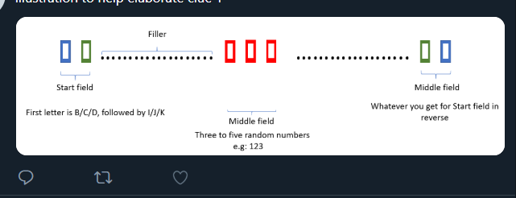
First Step
Control F GCTF
Base64 Decode
https://pastebin.com/TAVE5J94
They would need to go to the twitter for the second clue

Slide 5
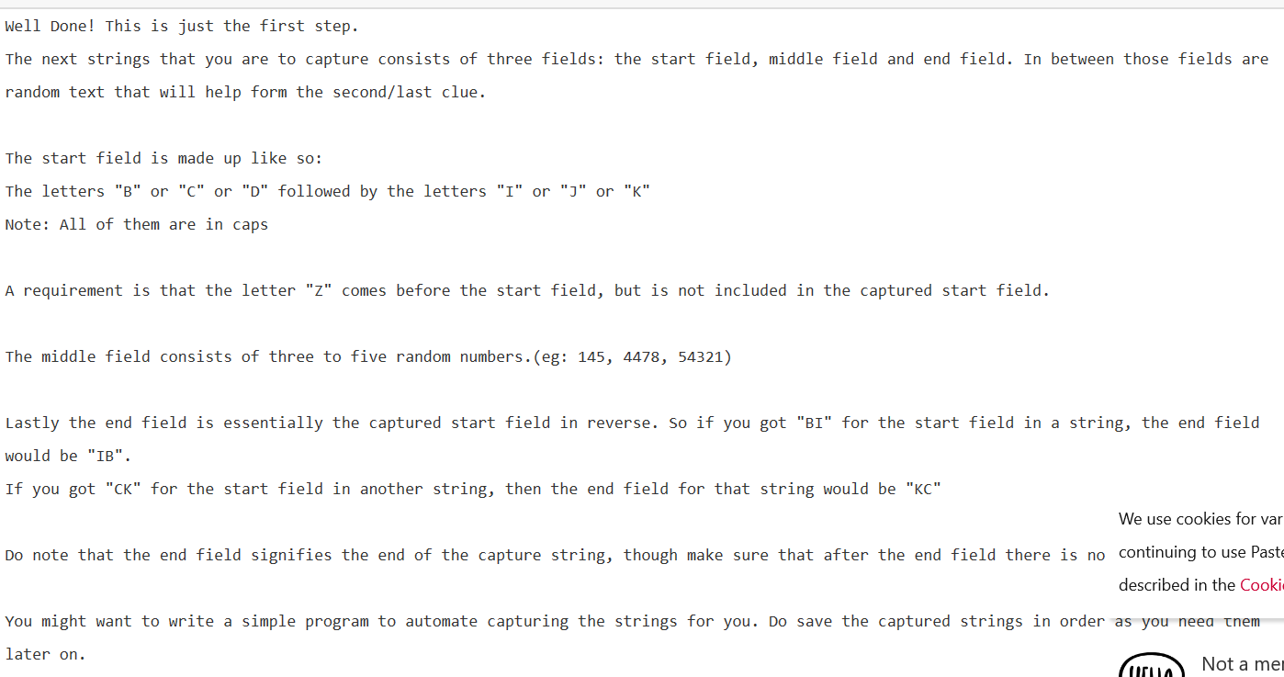
First Step.2: Blues Clues

Slide 6
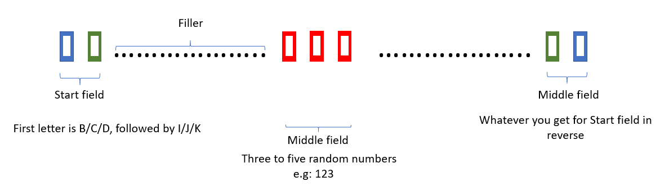
First Step.2: Blues Clues

Slide 7
My Ans:
(?<=Z)([B-D])([I-K]).*?\D?\d{3,5}\D?.*?\2\1(?!A)
(?<=Z) test that there is a Z at the start but does not capture the Z itself
([B-D])([I-K]) first letter B/C/D, followed by I/J/K Can be replaced by ([BCD])([IJK])
.*? All of the characters, 0 or more times Question mark that follows is
so that it will stop at the first match of a string of random characters ( non greedy)
\D? character that is not a digit (Because what follows are digits) Can be replaced by [\D]
\d{3,5} three to five digits
\2\1 Basically whatever you got for ([B-D])([I-K]) in reverse.
(?!A) Ensures that there is no A in front of the string

Slide 8
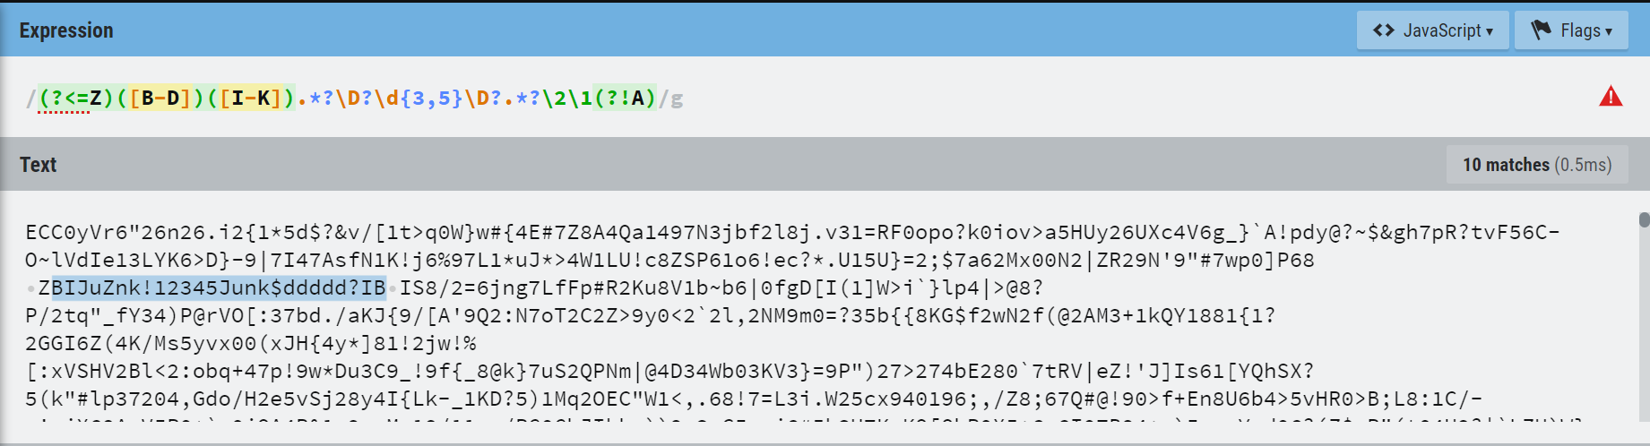
Time 4 Capture
Store Matched Strings in order!

Slide 9
Step 2: Convert
First Matched String: BIJuZnk!12345Junk$ddddd?IB
Text to Ascii: 66 73 74 117 90 110 107 33 49 50 51 52 53 74 117 110 107 36 100 100 100 100 100 63 73 66
Sum: 2071
In ASCII table 071 = G
Websites to help you: https://www.browserling.com/tools/text-to-ascii
http://www.unit-conversion.info/texttools/replace-text/ (change space to plus)

Slide 10
Convert: All
BIJuZnk!12345Junk$ddddd?IB → G
CKjudnddkZ543jduddn9kKC → C
DJmdedsds1654wdarZtdtJD → T
CJrde.adl584n2dMdodezZJC → F
BKddddZdddddd987a\adadKB → {
DKmd2adn679wdo2dmd8adnKD → F
CJd2$2^2d*1892de2d2di2dfdfJC → L
CJKdP2>OdK2F702wd@^Kd^2Kd2JC → a
BKoo987aalaKB → G
BJZP<(#7222d%<:JB → -
DI=EGL2334TalID → 4
DK+,BN465PXcfKD → -
CI)-8718XabduIC → R
DJ+466FWefoqJD → G
CKm2adldFads555mda2wd=dKC → }

Slide 11
End
A Certain Scientific Regex

